Slide 1

Introduction to Deep Learning
What is a
Neural Network?
deeplearning.ai

Slide 2
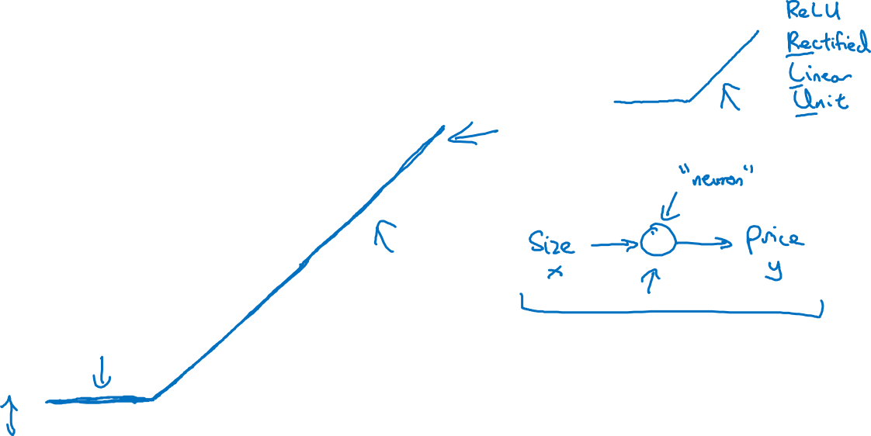
Housing Price Prediction
price
size of house

Slide 3
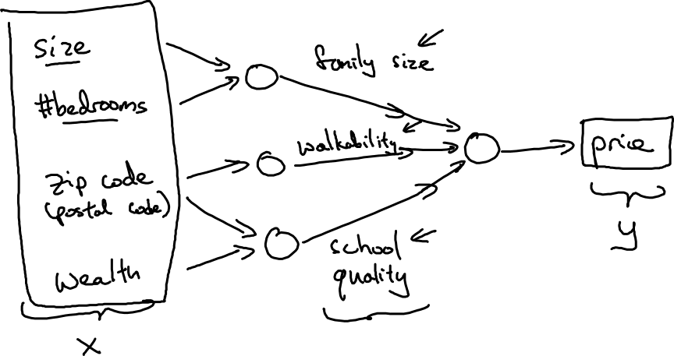
Housing Price Prediction

Slide 4

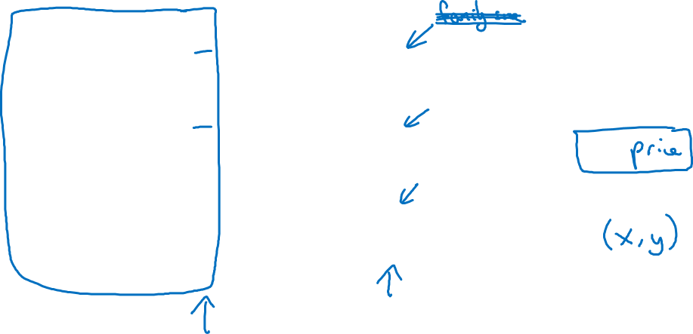
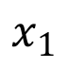
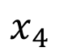
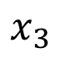
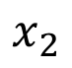
Housing Price Prediction
size
$$x_{1}$$
#bedrooms
$$x_{2}$$
y
zip code
$$x_{3}$$
wealth
$$x_{4}$$

Slide 5
Introduction to Deep Learning
Supervised Learning
with Neural Networks
deeplearning.ai

Slide 6
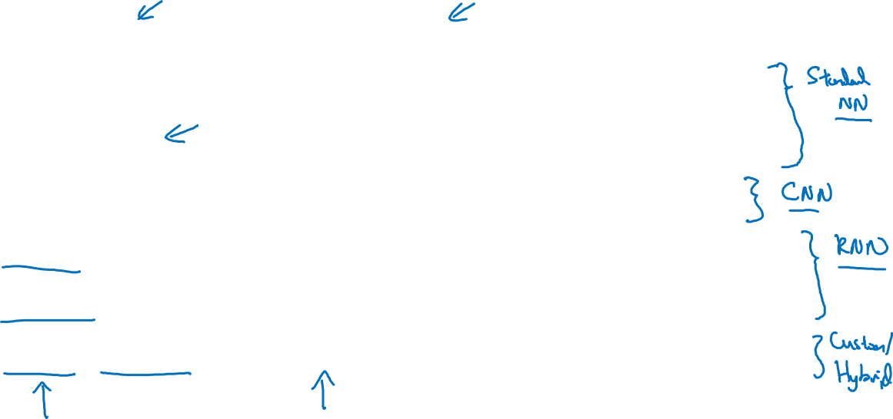
Supervised Learning
Input(x)
Output (y)
Application
Home features
Price
Real Estate
Ad, user info
Click on ad? (0/1)
Online Advertising
Image
Object (1,…,1000)
Photo tagging
Audio
Text transcript
Speech recognition
English
Chinese
Machine translation
Image, Radar info
Position of other cars
Autonomous driving

Slide 7
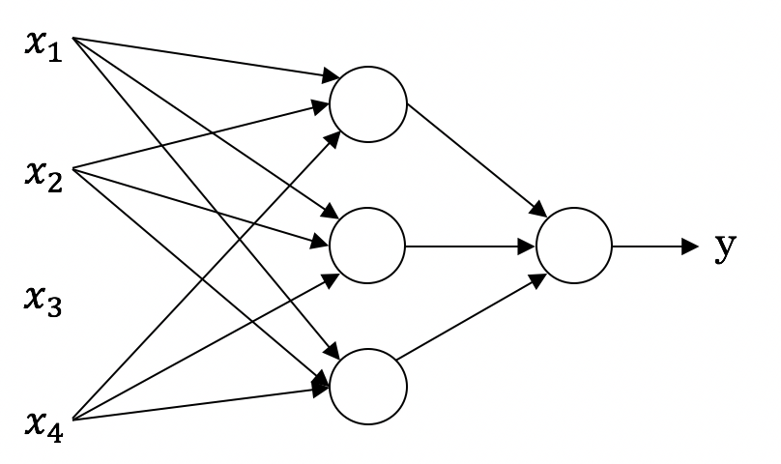
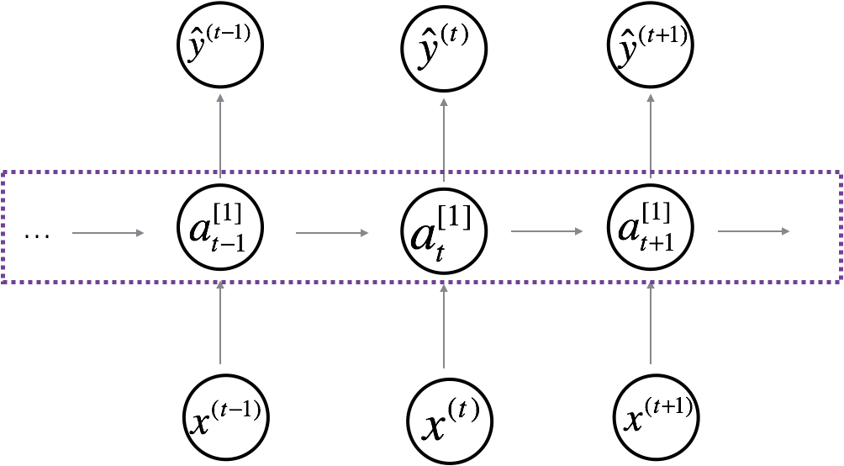

Neural Network examples
Standard NN
Convolutional NN
Recurrent NN

Slide 8



Supervised Learning
Structured Data
Unstructured Data
Size | #bedrooms | … | Price (1000$s)
2104 1600 2400 ⋮ 3000 | 3 3 3 ⋮ 4 |  | 400 330 369 ⋮ 540
Audio
Image
User Age | Ad Id | … | Click
41 80 18 ⋮ 27 | 93242 93287 87312 ⋮ 71244 |  | 1 0 1 ⋮ 1
Four scores and seven years ago…
Text

Slide 9
Introduction to Neural Networks
Why is Deep Learning taking off?
deeplearning.ai

Slide 10
Scale drives deep learning progress
Performance
Amount of data

Slide 11

Scale drives deep learning progress
Idea
Data
Computation
Algorithms
Experiment
Code

Slide 12
Introduction to Neural Networks
About this Course
deeplearning.ai

Slide 13

Courses in this Specialization
Neural Networks and Deep Learning
Improving Deep Neural Networks: Hyperparameter tuning, Regularization and Optimization
Structuring your Machine Learning project
Convolutional Neural Networks
Natural Language Processing: Building sequence models
Notes:
https://pixabay.com/en/cat-pets-cat-s-eyes-mieze-dear-451377/

Slide 14
Outline of this Course
Week 1: Introduction
Week 2: Basics of Neural Network programming
Week 3: One hidden layer Neural Networks
Week 4: Deep Neural Networks

